Slide 1
League of Legends Item Balancing Recommendations
Sebastian Alvis

Slide 2
Outline
Crash Course: League of Legends
Problem Statement
Data
Statistics
Conclusions

Slide 3
Outline
Crash Course: League of Legends
Problem Statement
Data
Statistics
Conclusions

Slide 4
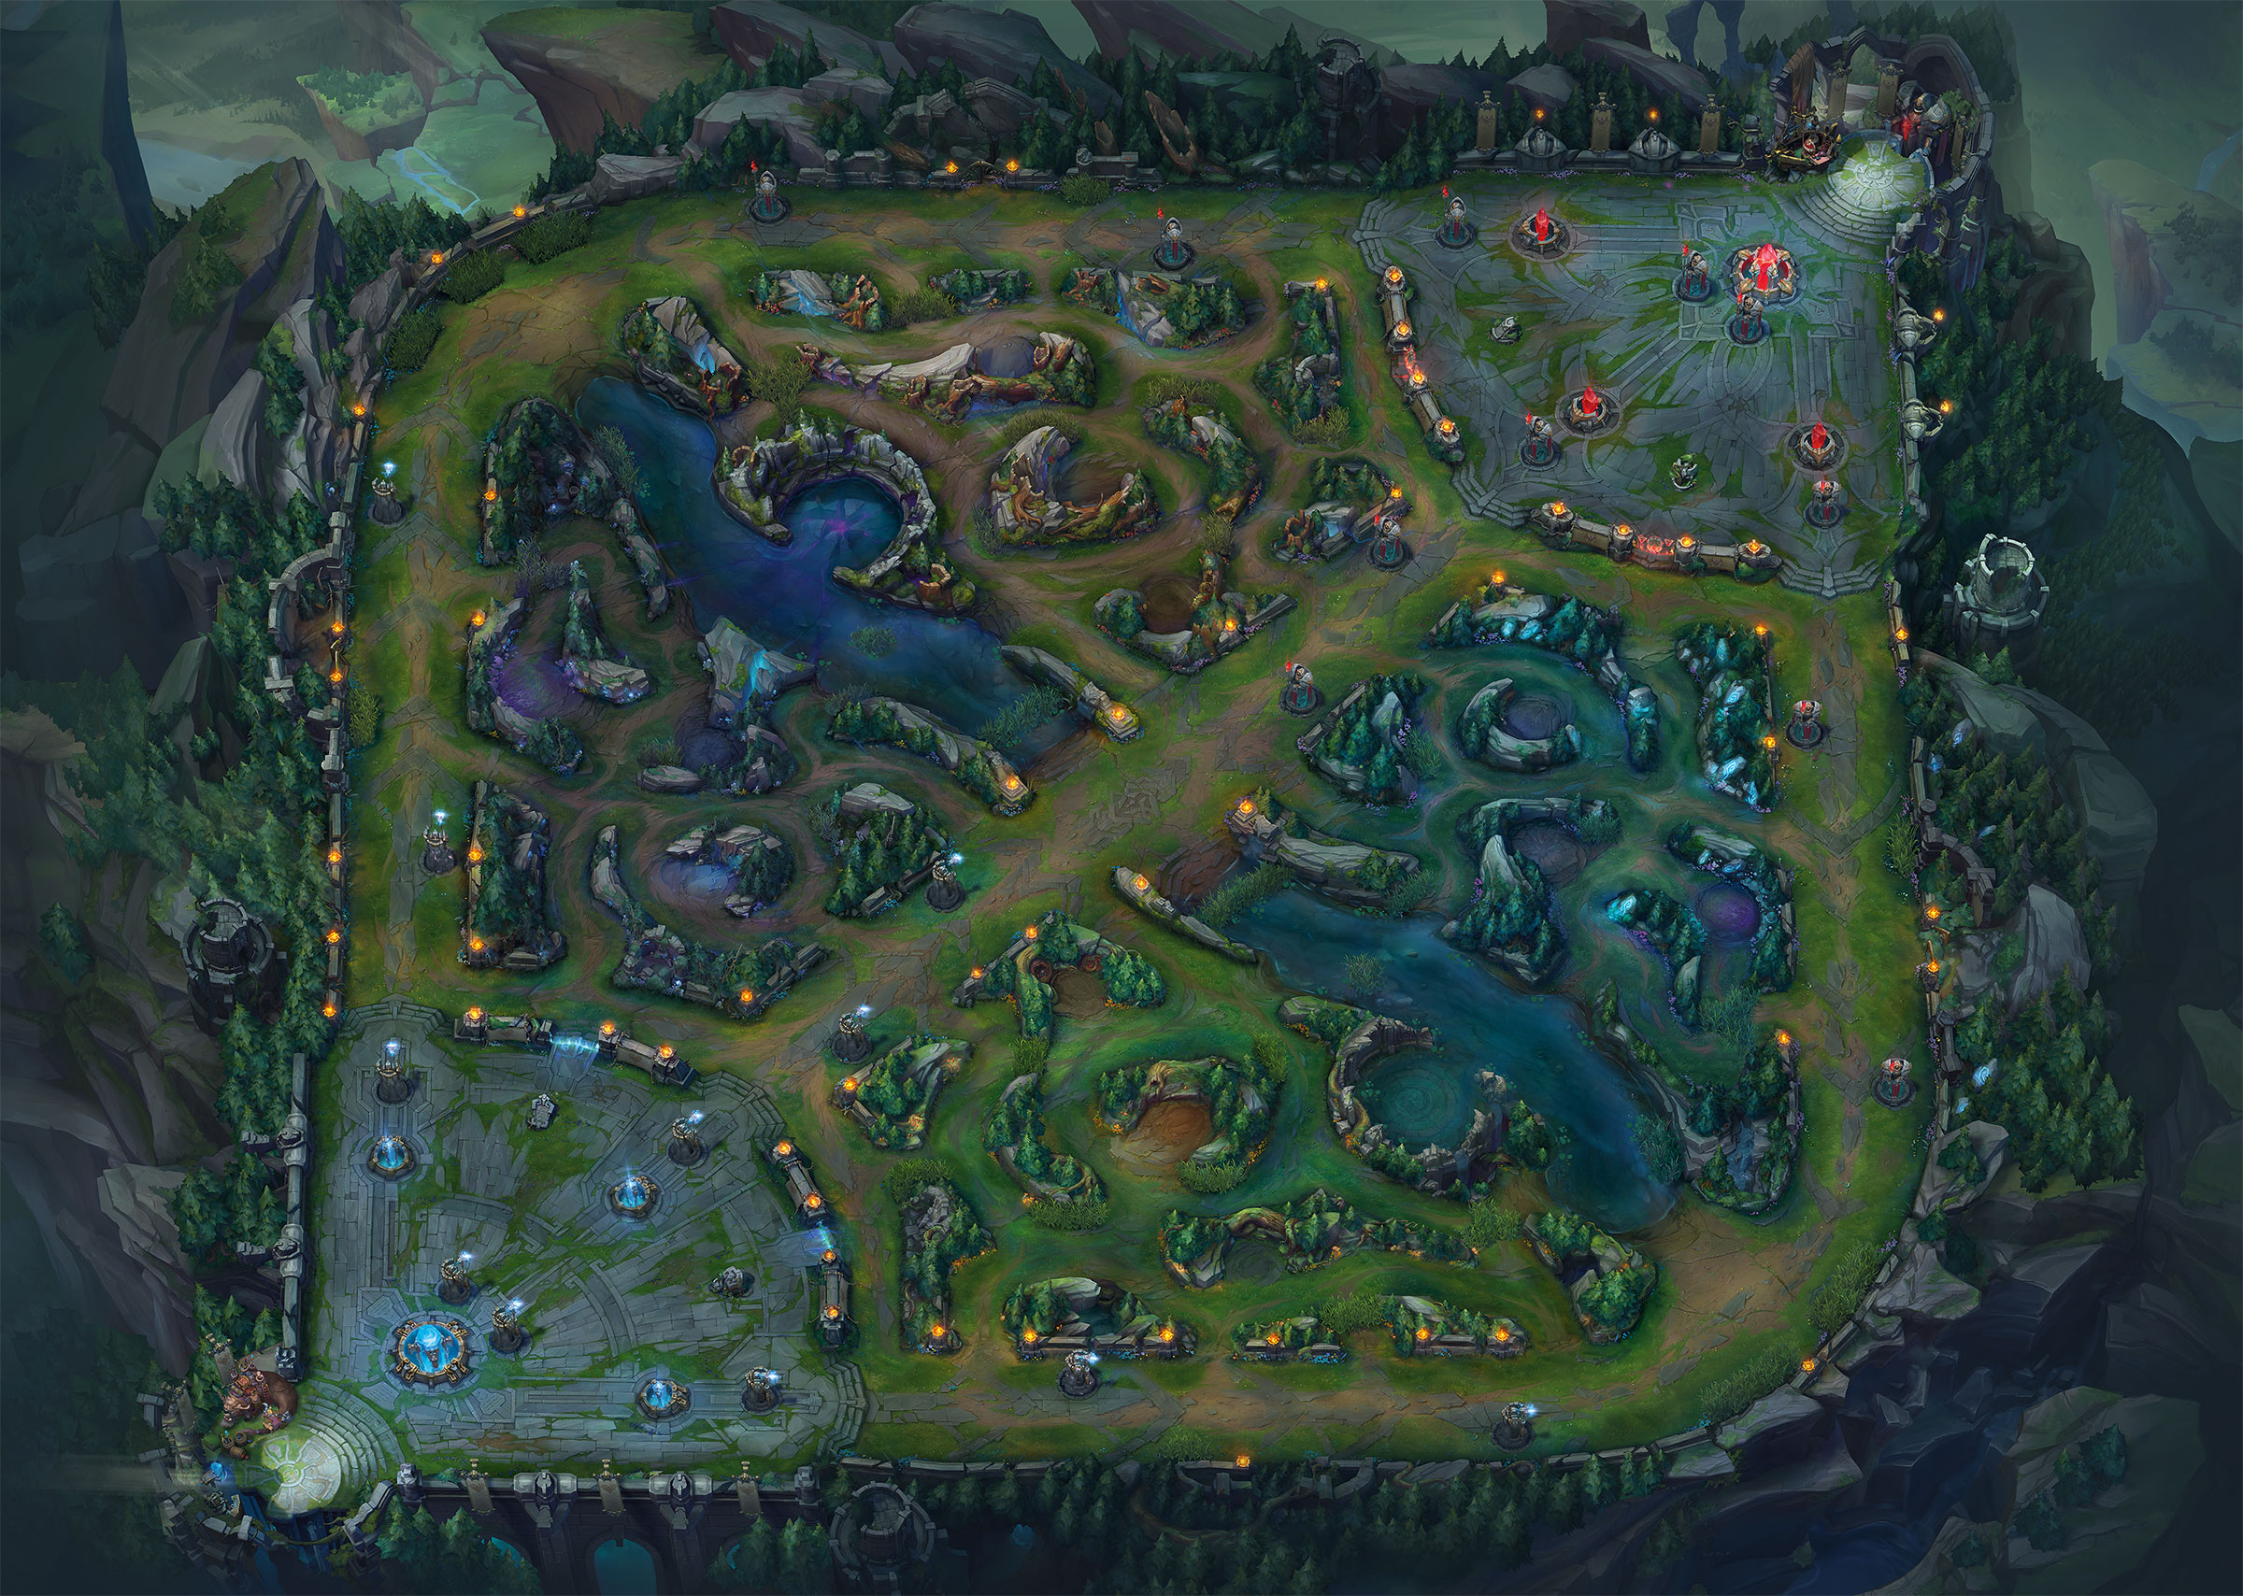
League of Legends: The Map
Summoner’s Rift
Both teams have bases
3 Lanes
Area between lanes is the Jungle
The River divides the map in half
Top Lane
Mid Lane
Bot Lane

Slide 5
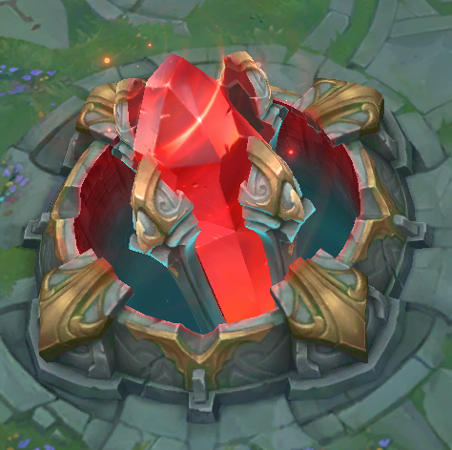
League of Legends: The Objective
Objective: Destroy the Nexus
Red Base Nexus
Blue Base Nexus

Slide 6

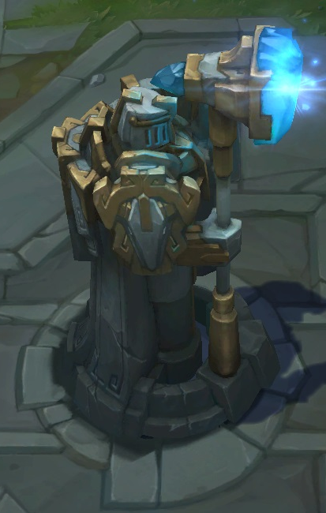
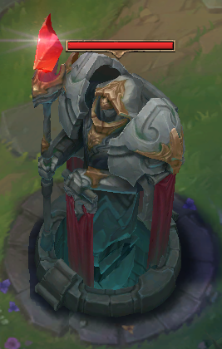
League of Legends: Towers
Towers block the lanes and shoot enemy champions and minions

Slide 7
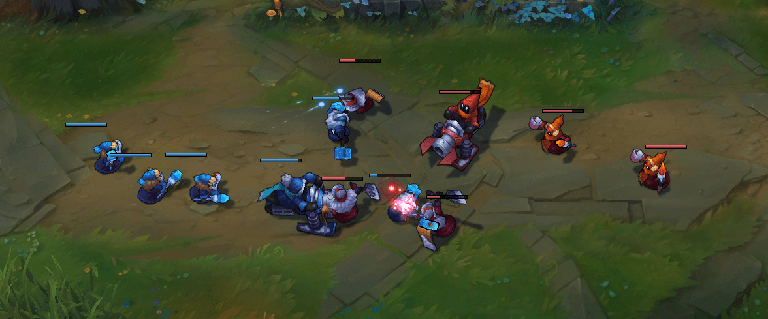
League of Legends: Minions
Objective: Destroy the Nexus
Lane Minions spawn in every lane to help get through structures
Red Base Nexus
Blue Base Nexus

Slide 8










League of Legends: Characters and Teams
Blue Team (Name/Role) | Position | Red Team (Name/Role)
Riven (Fighter) | Top Lane | Sion (Tank)
Jarvan IV (Tank) | Jungle | Sejuani (Tank)
Syndra (Mage) | Mid Lane | Lux (Mage)
Tristana (Marksman) | AD Carry (Bot Lane) | Twitch (Marksman)
Brand (Mage) | Support (Bot Lane) | Rakan (Support)
Starting Map Positions for players
Top, Mid, Bot, Support, Jungle
Maximize team gold
Various archetypes for champions
Assassin, Fighter, Mage, Marksman, Support, Tank
Archetype generally determines the kinds of items you buy

Slide 9
League of Legends: Laning
Objective: Destroy the Nexus
Players generally spend the first 15-20 min of the game in their lane

Slide 10
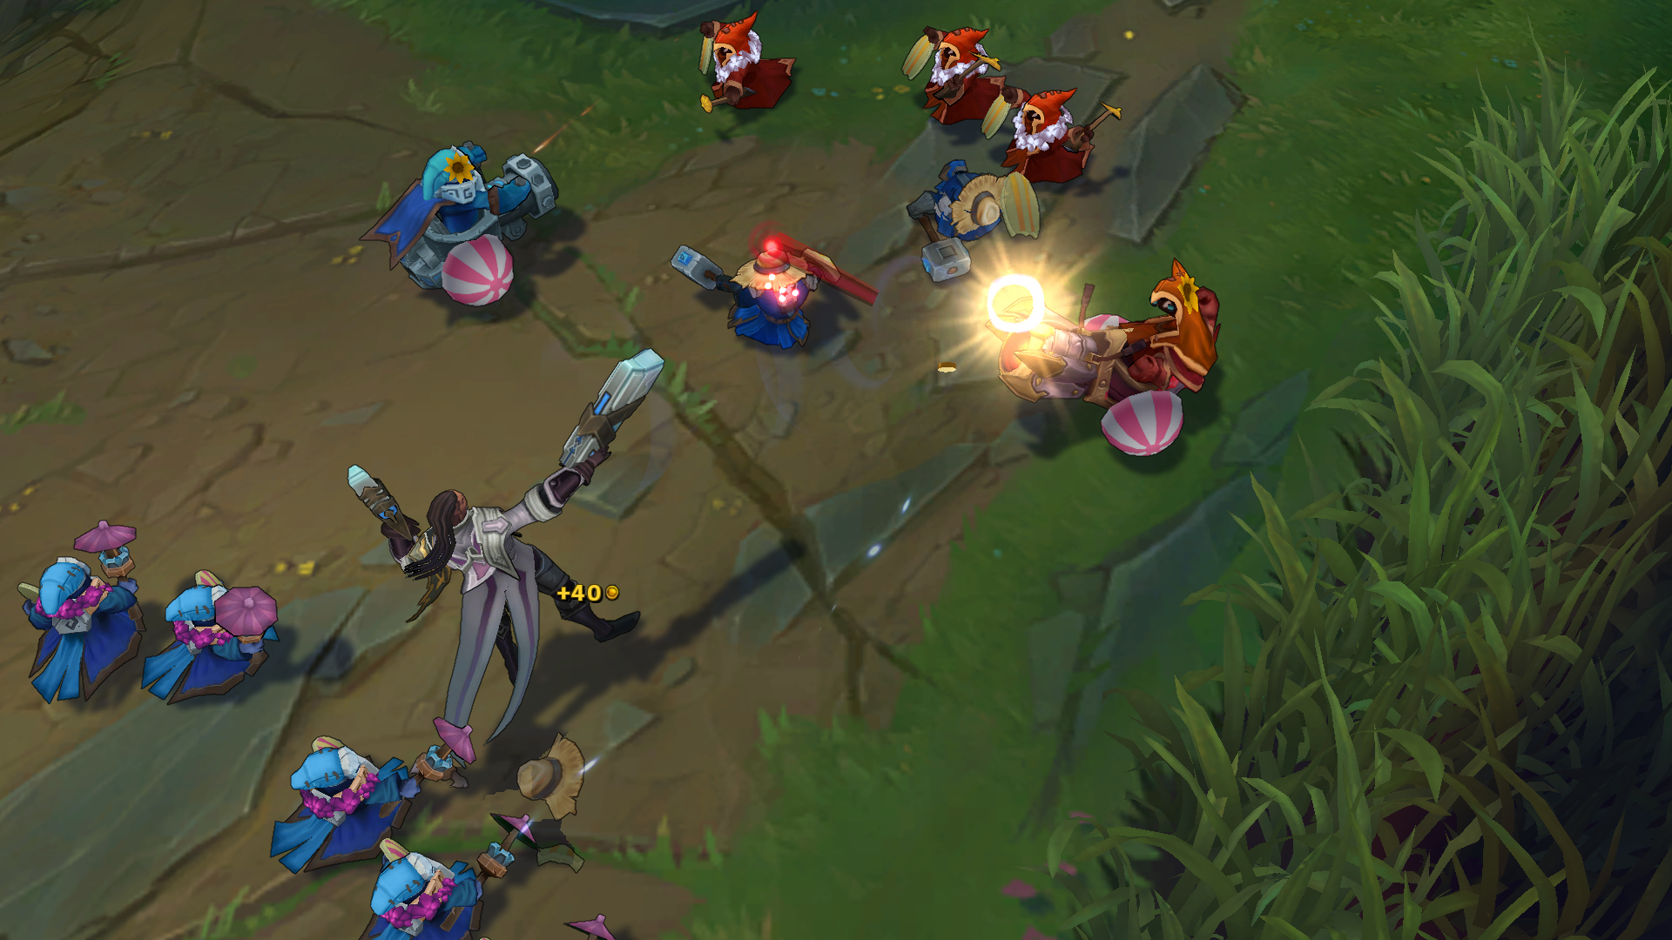
League of Legends: Laning
Objective: Destroy the Nexus
Players generally spend the first 15-20 min of the game in their lane
Kill enemy minions

Slide 11
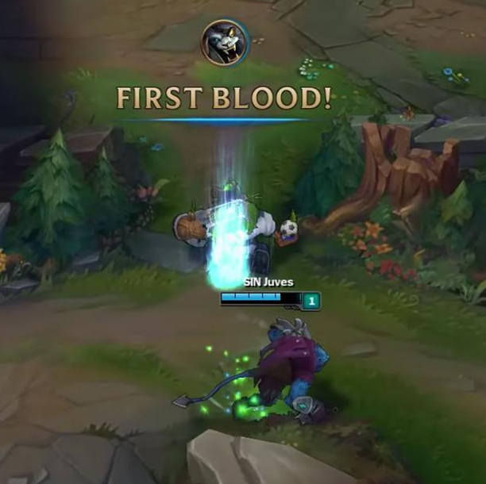
League of Legends: Laning
Objective: Destroy the Nexus
Players generally spend the first 15-20 min of the game in their lane
Kill enemy minions
Fight enemy champions

Slide 12
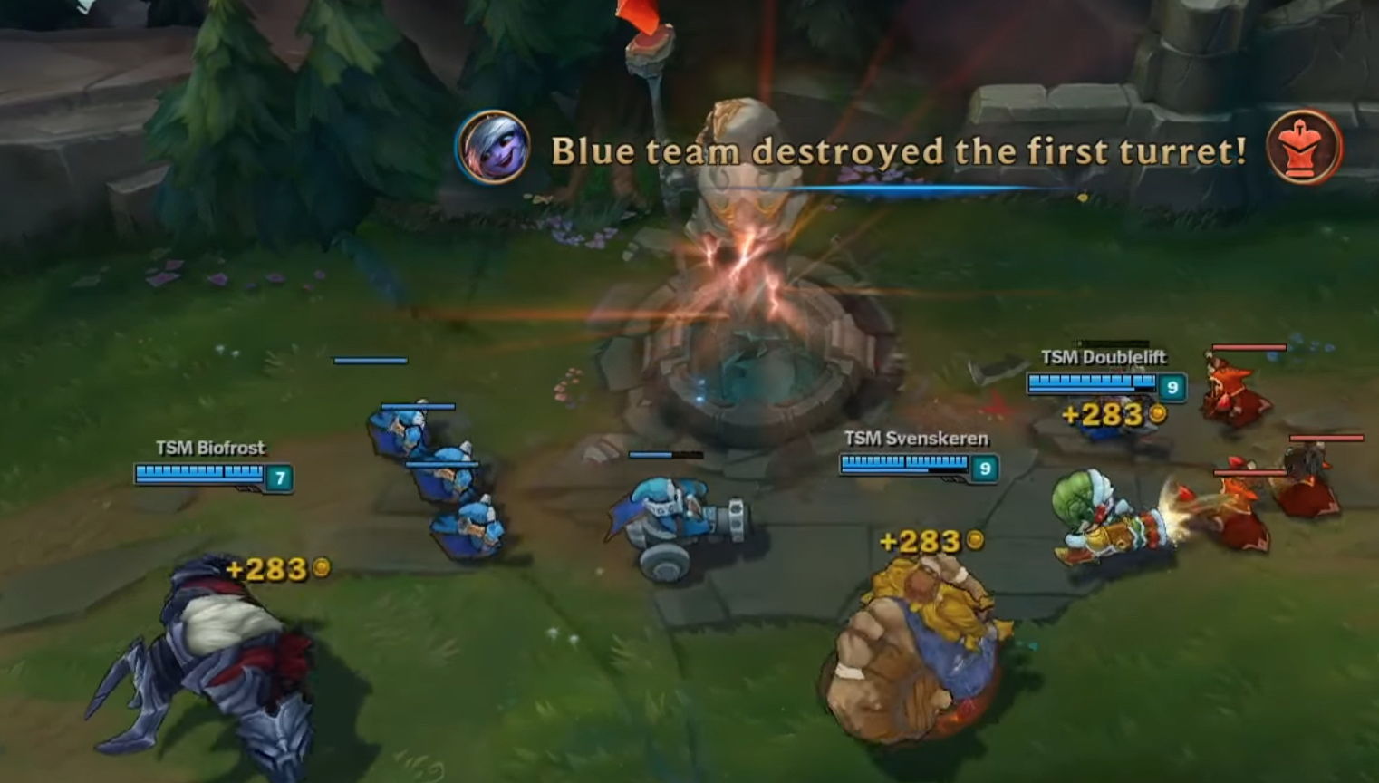
League of Legends: Laning
Objective: Destroy the Nexus
Players generally spend the first 15-20 min of the game in their lane
Kill enemy minions
Fight enemy champions
Destroy towers

Slide 13
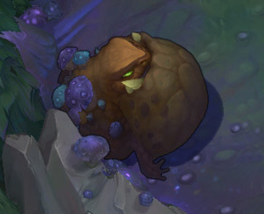
League of Legends: Laning
Objective: Destroy the Nexus
Players generally spend the first 15-20 min of the game in their lane
Kill enemy minions
Fight / kill enemy champions
Destroy towers
Kill jungle monsters

Slide 14
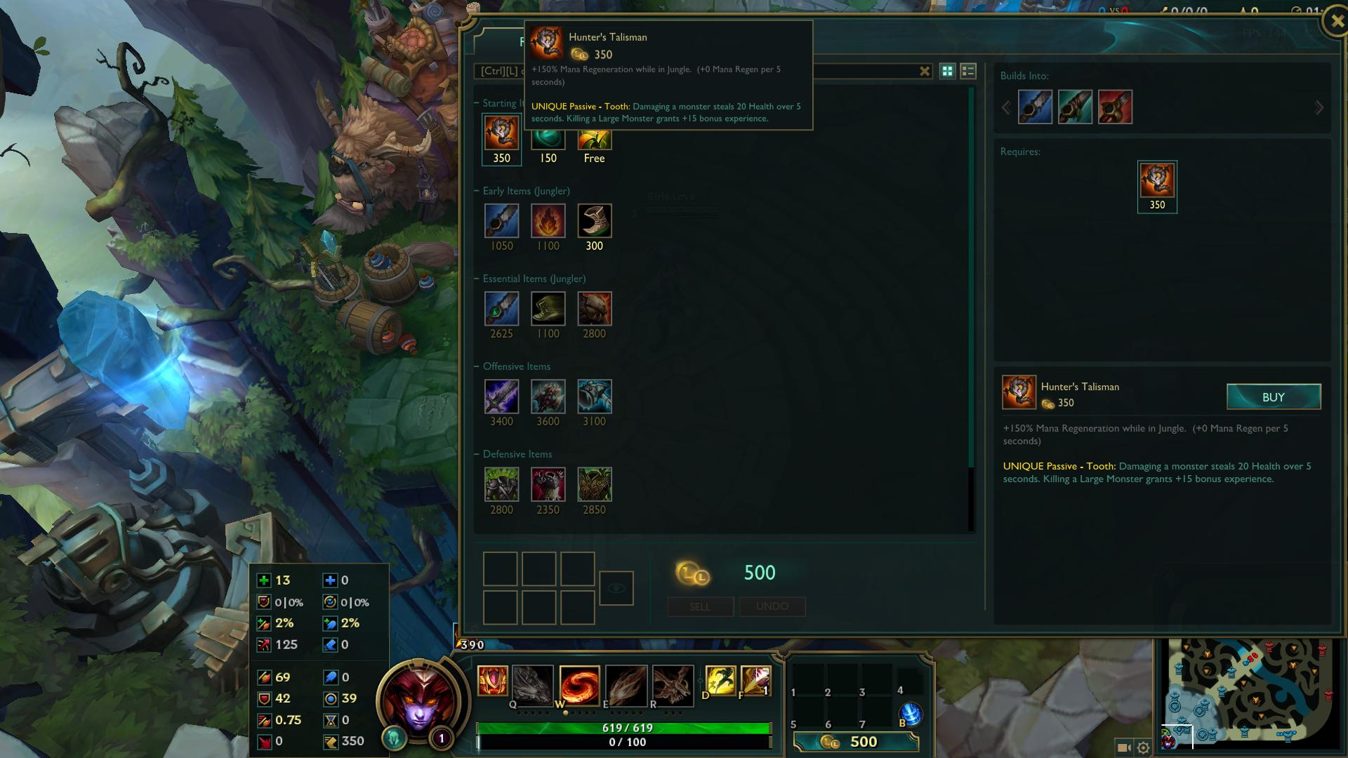
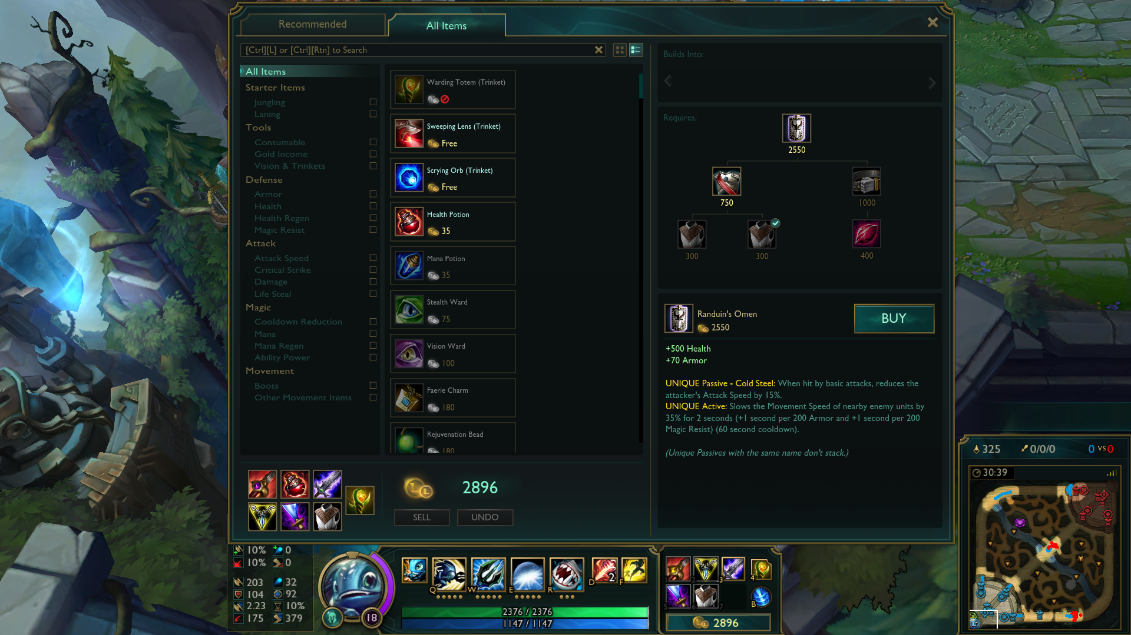
League of Legends: Money and Items
As players kill minions, champions, towers, and jungle monsters, they collect gold
Gold is spent on items, which upgrade various attributes of the champion
Items have a huge impact the game, and are one of the pillars of gameplay in LoL

Slide 15
Outline
Crash Course: League of Legends
Problem Statement
Data
Statistics
Conclusions

Slide 16
Why should you change items at all?
League of Legends currently has
141 champions
200+ items
Diversity is it’s strong suit as a game
Nobody wants to see the same set of champions and items every game
As a dev, you want to keep the game balanced so that lots of different champions and items show up
This makes the game more interesting

Slide 17
Problem Statement
As a developer, how do you know when you should change an item?

Slide 18
Outline
Crash Course: League of Legends
Problem Statement
Data
Statistics
Conclusions

Slide 19
“Static” Data
Acquired through the Riot Games Static API
Items
Champions
JSON files, flattened into tables
Wrinkle about the Unicode string/array problem
It is unlikely to change much – Static
Patches every week can tweak any given champion / item – “Static”

Slide 20
Match Data
Chosen from the Ranked Queue
Where people take the game more seriously
Only higher-level Leagues: Diamond and Platinum
Where people have more game knowledge and experience
1000 random players from these league selected
1000 random games from these players’ match histories selected
Requests
Game state at the end of the game
Timeline of events in the game

Slide 21
Dataframes
Matches
Final items, champions, item purchase times, win (True or False)
Items
Name, tags, cost, benefits
Champions
Name, tags
Item Statistics
Name, # purchased in matches, pick rate, # wins with item, win rate, # unique champions that purchased item, total gold, tags

Slide 22
Item Stats: Win Rate
# of occurrences / # of occurrences with a win
Bernoulli variable
Easy to test
Easy to understand
Can immediately tell if an item wins too much or too little
However, if players on both teams build an item, then one will win and one will lose
Win rate drifts closer to 50%

Slide 23
Item Stats: Pick Rate
How often an item is bought
A metric of popularity
Popularity often indicates what is strong
This helps us when win rate can’t
Also pretty easy to understand

Slide 24
Item Stats: Champion Spread
How many unique champions buy an item
141 champions total
Low champion spreads indicate low versatility
High champion spreads indicate excessive flexibility
Or very good value

Slide 25
Final Item Dataset
There are 200+ items in League
I don’t want to look at all of them
Remove
Incomplete items (that build into other items)
Starting items (Lane, Consumables)
Items with less than 10 occurrences in my match data
Resultant table has 80 items

Slide 26
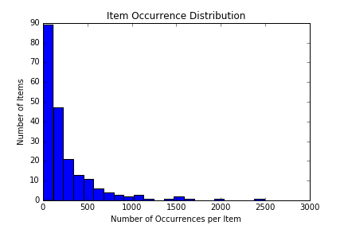
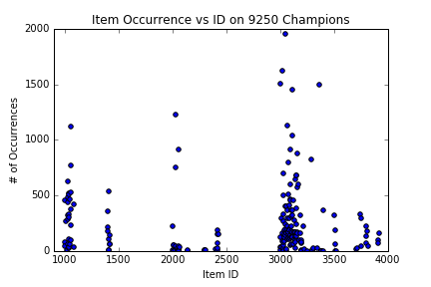
Item Occurrence (Do I even need this plot?)
The highest 7 points around ID 3000 are wards and boots.
The high points around 2000 are refillable potion and control ward.
The high point around ID 1000 is Doran’s Blade.
Most full items are of ID > 3000

Slide 27
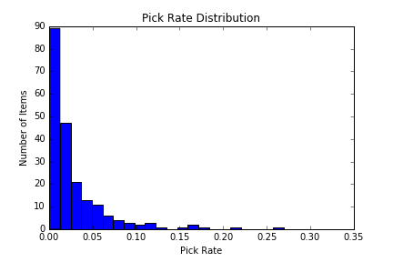
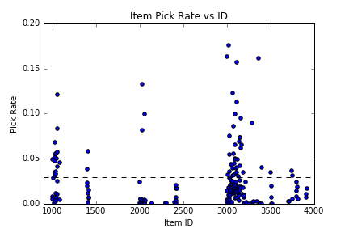
Item Pick Rate (change to full items)
Same distributions, but the numbers are now normalized

Slide 28
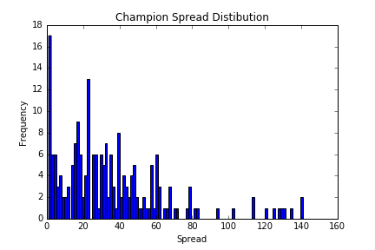
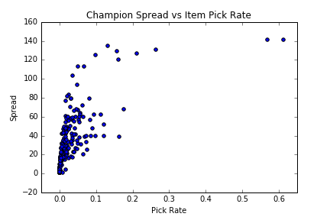
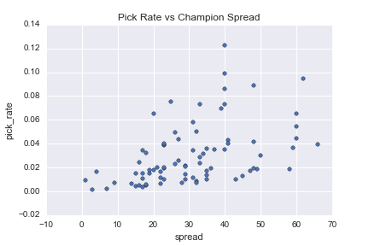
Champion Spread (change to full items)
How many unique champions each item gets built on
Correlates well with pick rate

Slide 29
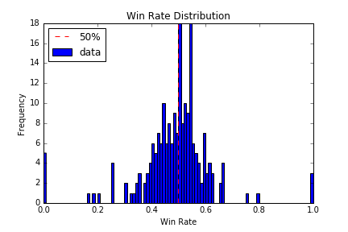
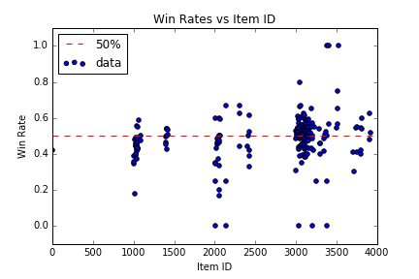
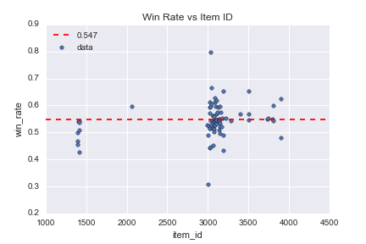
Win Rates (change to full items)
The probability that a player wins with a given item

Slide 30
Correlations??
Need to refine this section later
Or just scrap it and merge with the previous one

Slide 31
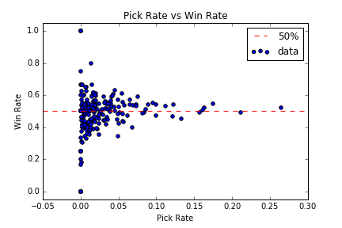
Pick Rate vs Win Rate
This illustrates the problem with gauging performance on win rate alone.
The more an item gets picked, the more likely players on both sides are to pick the same items
This drags the win rate to 50%

Slide 32
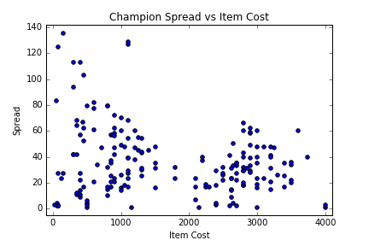
Champion Spread vs Item Cost
a

Slide 33
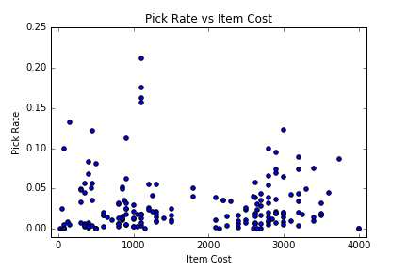
Pick Rate vs Item Cost

Slide 34
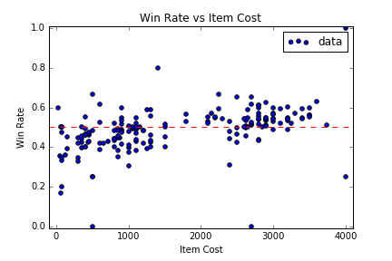
Win Rate vs Item Cost
This shows that finishing an item is good for your chances of winning
The final analysis will use mostly the right lobe
Focusing on full items and which ones are too strong / weak

Slide 35
Purchase Timing

Slide 36
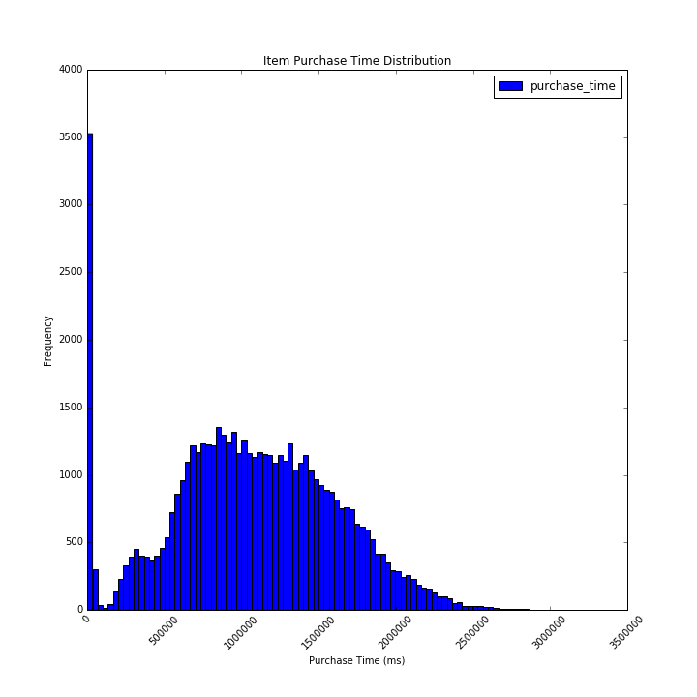
Item Purchase Time
This is for all the items that a player ends the game with.

Slide 37
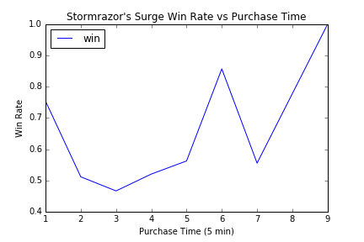
Example Item: Stormrazor’s Surge

Slide 39
Outline
Crash Course: League of Legends
Problem Statement
Data
Statistics
Conclusions

Slide 40
Statistics: Abnormal Win Rates
Since win rate is Bernoulli, it’s easy to estimate a sample std
Establish a 95% Confidence Interval around each items’ win rate
See which items have a 95% CI that doesn’t include the mean 54.7% win rate

Slide 41
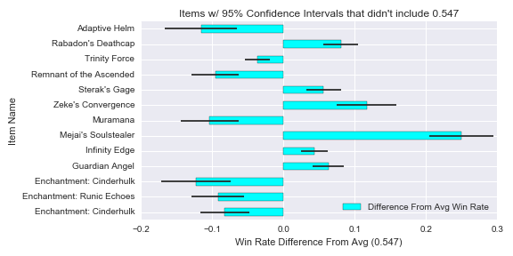
Statistics: Abnormal Win Rates

Slide 42
Aggregate by Item Tags
Items can be grouped into sets based on the bonuses they give
Example tags:
Damage
SpellDamage
Health
Armor
SpellBlock
AttackSpeed

Slide 43
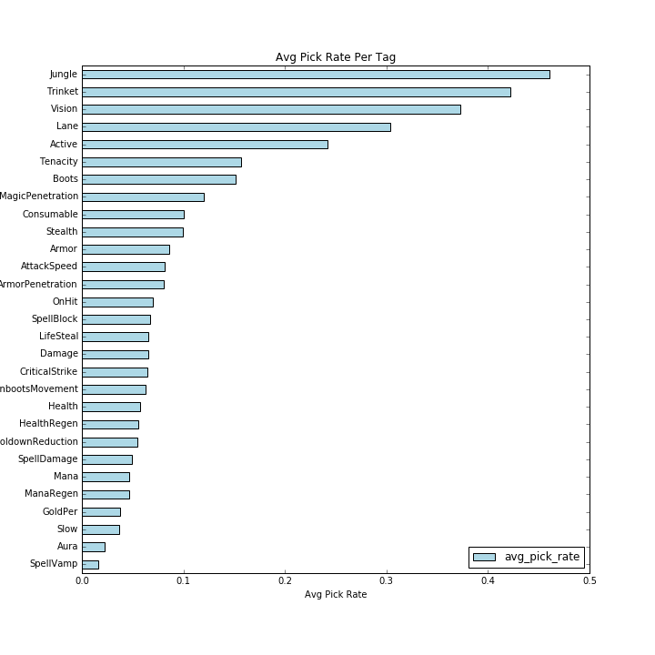
Pick Rate vs Tag

Slide 44
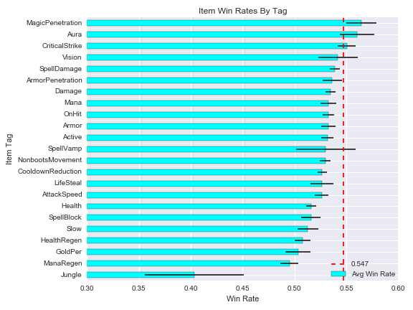
Win Rate Per Tag
Average win rate for all items of the tag
Std deviation of the win rate for the tags’ items

Slide 45
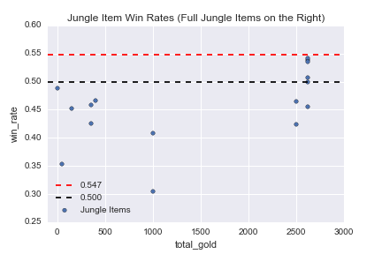
Statistics: Jungle Items
My initial thought was that the avg win rate would be 0.50
Focusing on full items, it made sense that most win rates would be higher than 0.50
Jungle items do not follow this trend, but instead sit around 0.50
One player per team builds a jungle item, almost always first
Incomplete jungle items are uncommon.

